Slide 1
Object Oriented Programming

Slide 2
Topics To Be Covered Today
Interface
Interface vs. Class
Interface inheritance
Multiple Inheritance with Interface
Java 8 Default Method in Interface
Default Methods and Multiple Inheritance
Java 8 Static Method in Interface
Abstract Class vs. Interface

Slide 3
Interface
A blueprint of a class which has static constants and abstract methods.
A mechanism to achieve abstraction
There can be only abstract methods in interface
A class implements an interface, thereby inheriting the abstract methods of the interface.
A class that implements interface must implement all the methods declared in the interface.
Java Interface also represents IS-A relationship.
It cannot be instantiated just like abstract class.

Slide 4
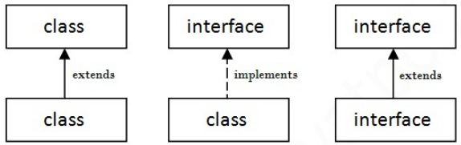
Interface VS Class
Writing an interface is similar to writing a class. But:
A class describes the attributes and behaviors of an object.
While an interface contains behaviors that a class implements.
a class extends another class, an interface extends another interface but a class implements an interface.

Slide 5
Interface is similar to class
An interface is similar to a class in the following ways:
An interface can contain any number of methods.
An interface is written in a file with a .java extension, with the name of the interface matching the name of the file.
The byte code of an interface appears in a .class file.
Interfaces appear in packages, and their corresponding bytecode file must be in a directory structure that matches the package name.

Slide 6
Interface is different from a class
An interface is different from a class in several ways:
An interface cannot be instantiated.
An interface does not contain any constructors.
All of the methods in an interface are abstract.
An interface cannot contain instance fields. The only fields that can appear in an interface must be declared both static and final.
An interface is not extended by a class.
it is implemented by a class.
An interface can extend multiple interfaces.
Notes:
A class cannot extend multiple classes. (Multiple Inheritance)

Slide 7
Why use Java interface?
There are mainly three reasons to use interface
It is used to achieve abstraction.
By interface, we can support the functionality of multiple inheritance.
It can be used to achieve loose coupling.
Loose coupling just means that components are able to work together without assuming anything about the internal workings of each other.
https://stackoverflow.com/questions/19483626/how-is-loose-coupling-achieved-using-interfaces-in-java-when-an-implementation-c

Slide 8
How to declare interface?
Interface is declared by using interface keyword
/* File name : NameOfInterface.java */
public interface NameOfInterface {
// Any number of final, static fields
// Any number of abstract method declarations
}
Interfaces have the following properties:
An interface is implicitly abstract.
You do not need to use the abstract keyword while declaring an interface.
Each method in an interface is also implicitly abstract, so the abstract keyword is not needed.
Methods in an interface are implicitly public and abstract while all fields are public, static and final by default.

Slide 9
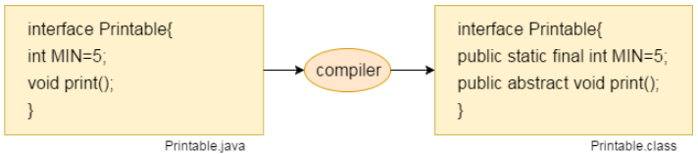
Internal addition by compiler
Interface fields are public, static and final by default, and methods are public and abstract.
The java compiler adds internally:
public and abstract keywords before the interface method.
public, static and final keywords before data members.
Notes:
Since Java 8, interface can have default and static methods which is discussed later.

Slide 10

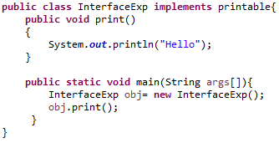
Example
Printable interface having only one method
Implementation is provided in the InterfaceExp class.
//What if I remove public??
Notes:
Printable obj= new InterfaceExp();
Hello

Slide 11
Implementing Interfaces
When a class implements an interface, there are several rules:
Sign a contract, agreeing to perform the specific behaviors of the interface.
If a class does not perform all the behaviors of the interface, the class must declare itself as abstract
An interface can extend another interface, in a similar way as a class can extend another class.
A class can extend only one class, but can implement more than one interface at a time.

Slide 12

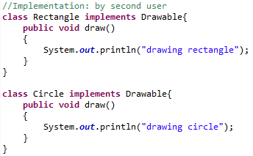
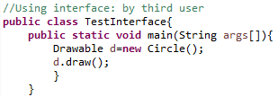
Interface Example: Drawable

Slide 13
Explanation
In this example:
Drawable interface has only one method.
Its implementation is provided by Rectangle and Circle classes.
In real scenario, interface is defined by someone but implementation is provided by different implementation providers.
And, it is used by someone else.
The implementation part is hidden by the user which uses the interface.

Slide 14
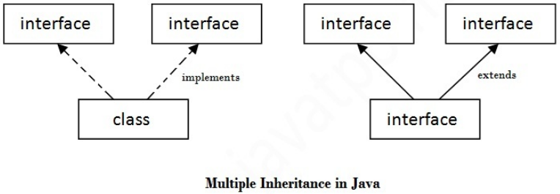
Multiple inheritance by interface
If a class implements multiple interfaces, or an interface extends multiple interfaces i.e. known as multiple inheritance

Slide 15


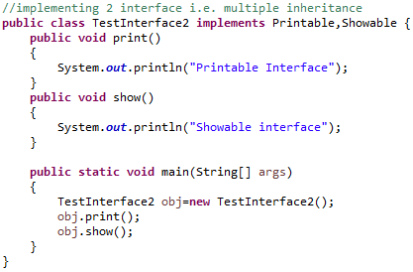
Example
Notes:
TestInterface used to access methods of both interface, if reference variable of any implemented interface is created, this reference variable can access only corresponding method defined in that interface, cant access other’s.

Slide 16
Question
Q)Multiple inheritance is not supported through class in java but it is possible by interface, why?
Answer:
multiple inheritance is not supported in case of class because of ambiguity
But it is supported in case of interface because there is no ambiguity
As implementation is provided by the implementation class not the implemented interface

Slide 17

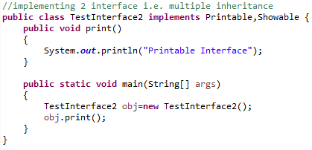
Example

Slide 18

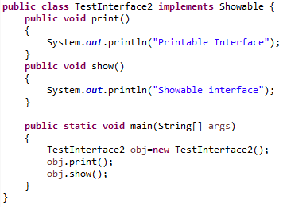
Interface inheritance: Extend Interface

Slide 19


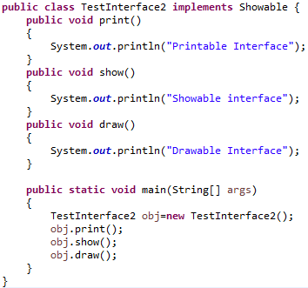
Extending Multiple Interfaces
//Multiple Inheritance
Notes:
It will be written as:
Showable obj=new TestInterface2();

Slide 20
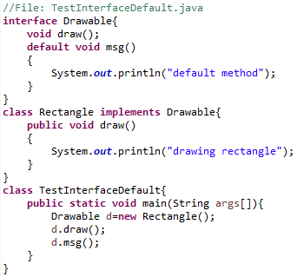
Java 8 Default Method in Interface
Since Java 8, we can have method body in interface. But we need to make it default method

Slide 21
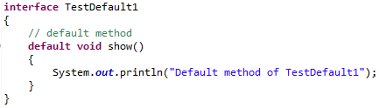
Default Methods and Multiple Inheritance
Suppose, both the implemented interfaces contain default methods with same method signature, then which method will be called ???
The implementing class should explicitly specify which default method is to be used or it should override the default method.
Notes:
/* A simple Java program to demonstrate multiple inheritance through default methods. */
https://www.geeksforgeeks.org/default-methods-java/

Slide 22

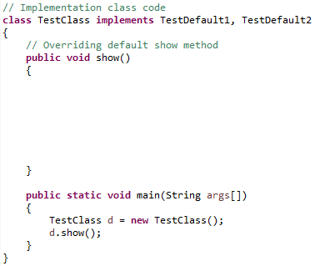


Contd.

Slide 23
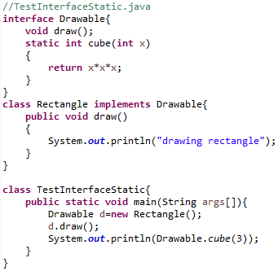
Java 8 Static Method in Interface
Since Java 8, we can have static method in interface

Slide 24
Question
Q) Can an Interface be final?
No, because its implementation is provided by another class.
Q)Can we define private and protected modifiers for variables in interfaces?
No, they are implicitly public.
Q) What is similarity between abstract class and interface?
both are used to achieve abstraction where we can declare the abstract methods.
both can't be instantiated.

Slide 25
Abstract Class VS Interface
Abstract class can have abstract and non-abstract methods.
Abstract class doesn't support multiple inheritance.
Abstract class can have final, non-final, static and non-static variables.
Abstract class can provide the implementation of interface.
The abstract keyword is used to declare abstract class.
Interface can have only abstract methods.
Since Java 8, it can have default and static methods also.
Interface supports multiple inheritance.
Interface has only static and final variables.
Interface can't provide the implementation of abstract class.
The interface keyword is used to declare interface.
Abstract class
Interface
Notes:
Simply, abstract class achieves partial abstraction (0 to 100%) whereas interface achieves fully abstraction (100%).

Slide 26
Abstract Class VS Interface(Contd.)
An abstract class can extend another class and implement multiple interfaces.
An abstract class can be extended using keyword “extends”.
An abstract class can have class members like private, protected, etc.
public abstract class Shape{
public abstract void draw();
}
An interface can extend another interface only.
An interface class can be implemented using keyword “implements”
Interface can also be extended using extend keyword
Members of a Java interface are public by default.
public interface Drawable {
void draw();
}
Abstract Class
Interface

Slide 27
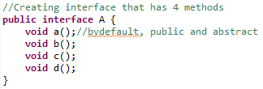
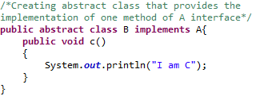
Example of abstract class and interface in Java

Slide 28
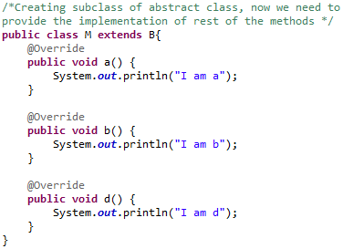
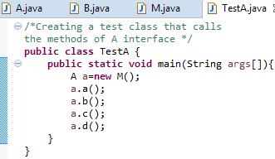
Contd..

Slide 29
Questions?

